Slide 1
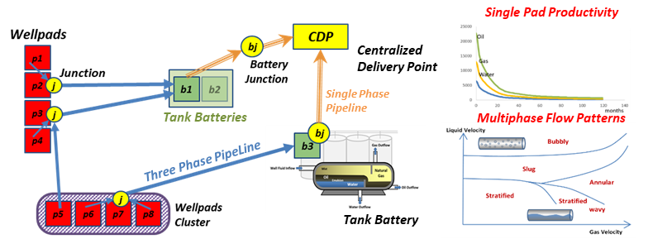
Graphical abstract
Solution Algorithm
Initialize
Iteration n=0
lower bound LB₀ =-inf |upper bound UB₀ =inf
MinBat₀=1 | MaxBat₀=#TB
best solution Z₀= inf
Solve NLP Formulation for every potential triplet in the superstructure. Set MaxFlow_{i,j,d}
Pre-processing
Cut-off infeasible combinations
Determine bound MinBat₀ (feasibility proof) on the number of TB to install → set LB₀
Iteration n=n+1
Solve MILP formulation with a limit of H_{n} CPU hours of computation → New global solution Z_{n}
End
Z_{n} = Z*
Yes
Is Z_{n} optimal?*
No
Determine bound MaxBat_{n} (against Z_{n}) on the TB to install by the heuristic procedure
Lower Bound improvement strategy
SuperBattery and Topological Constraints.
Solve the relaxed problem (RP) applying MinBat_{n} and MaxBat_{n} parameters. Solution: Z_{n}*^{RP} → LB_{n} =Z_{n}*^{RP}

